Slide 1
Victorian Disability Worker Commission Disability worker Regulation Scheme Lifestyle Centered Services
Notes:
Good morning
I would like to acknowledge that I am joining you from the lands of the Wurundjeri Woi-wurrung people. I pay my respects to their Elders, past and present, and the Aboriginal Elders of other communities where you are joining from or who are joining us today.
My name is Dan Stubbs, and I am the Victorian Disability Worker Commissioner.
I’m here to tell you about the Victorian Disability Worker Regulation Scheme, and the two main streams of work it does to improve the quality of services provided to people with disability and how it safeguards those people using services.
And I’m here to encourage you to become a registered worker with the Victorian Disability Worker Commission.

Slide 2
Why we do what we do
Notes:
I think it’s important to start with a few words about why we do what we do and what we are trying to achieve. And that is the different ways people with disability can participate in community, and we have a shared purpose is this.

Slide 3
Disability Services Safeguards Act 2018 (Vic)
Notes:
The Victorian Disability Worker Commission is an independent body established to administer the Disability Worker Regulation Scheme.
The Scheme was established by the Disability Service Safeguards Act 2018 (Vic) and involves the regulation of all disability workers in Victoria.
The scheme aims to reduce the risk of neglect and abuse of people with disability in Victoria and has 4 key functions:
1. A Code of Conduct for all Victorian disability workers
2. Mandatory notifications – all Victorian disability workers and employers must notify the Commission if they believe that a worker has engaged in certain types of misconduct
3. An independent complaints service; and
4. Disability worker registration, which assesses disability workers to ensure they meet standards for safety, skills and professionalism.
The Victorian Disability Worker Commission oversees the strongest safeguards in Australia for disability workers, providing greater protection for people with a disability. However, we not the only safeguard…

Slide 4
Regulatory environment
Notes:
In Victoria, many bodies work together to support safe disability services. We work with other agencies and organisations, as well as other regulators including:
Disability Services Commissioner
Social Services Regulator
NDIS Quality and Safeguard Commission
Victorian Equal Opportunity and Human Rights Commission
Office of the Public Advocate
And many others.
We work with these other regulators and agencies in Victoria and nationally to achieve quality and safety outcomes for people with disability.

Slide 5
Code of Conduct
Notes:
So how do we do this? The first element of the Disability Worker Regulation Scheme is the Disability Worker Code of Conduct. The Code is designed to promote a safe and skilled disability workforce within Victoria. The Code adopts the same requirements as the NDIS Code of Conduct. This means the same requirements apply to all disability workers, regardless of whether they are funded through NDIS or other providers.
The Code covers conduct relating to respect for the freedom of self-expression, self-determination and decision-making, as well as the privacy of people with disability.
It also covers conduct relating to the quality of services provided. The Code seeks to ensure services are provided in a safe and competent manner, and that disability workers act with integrity, honesty and transparency. It also requires disability workers promptly take steps to raise and act on any concerns about services provided to people with disability.
The code also covers conduct regarding safety ensuring disability workers take all reasonable steps to prevent and respond to all forms of sexual misconduct as well as violence against, and exploitation, neglect, and abuse of, people with disability.
All disability workers are required to adhere to the Code. It is important that all disability workers are aware of this requirement, and of their obligations to make mandatory notifications to the Commission.
Workers, and employers, are required to notify the Commission if they become aware that workers have engaged in notifiable conduct. If you suspect that a disability worker has breached the Code, we encourage you to report it to the Commission.

Slide 6
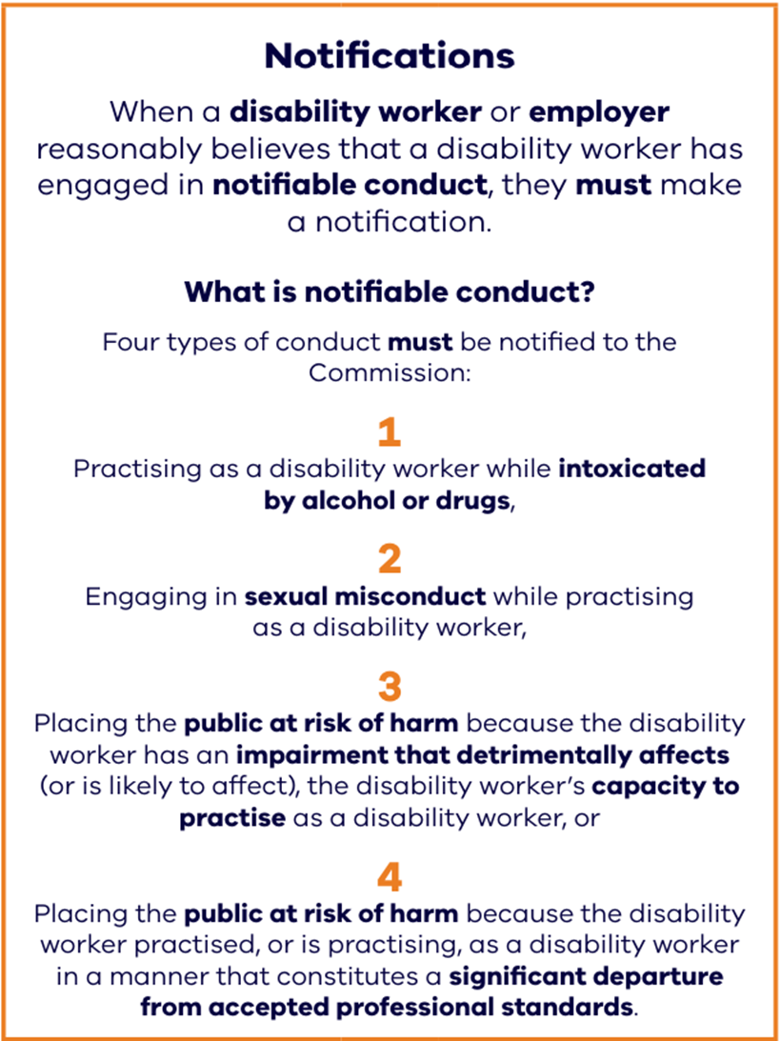
Complaints and Mandatory Notifications
Notes:
We can receive any enquiry, complaint or notification about any disability worker in Victoria, whether they are registered or unregistered.
Disability workers and employers must tell us about a concern that a disability worker may be putting safety at risk, this is called a ‘notification’.
When a disability worker or employer reasonably believes that a disability workers has engaged in notifiable conduct, they must notify the commission.
Notifiable conduct includes when a worker has practiced while intoxicated by alcohol or drugs, if a worker has engaged in sexual misconduct while working, the worker may be placing the public at risk of harm because they have an impairment or because they are practicing in a manner that is a significant departure from professional standards.

Slide 7
Complaints and Mandatory Notifications
Notes:
If you have any concerns about a disability worker, because for example, you have seen unprofessional behaviour and in your view, it does not match the code of conduct, you can and should contact the Commission to discuss.
This part of the Disability Worker Regulation Scheme helps make the Commission aware of potential risks to disability service users, so we can better prevent abuse and protect people with disability from harm.
You can make a notification or raise a complaint with the Commission online or over the phone.
If your concern is not something the Victorian Disability Worker Commission can take a complaint about, we will do our best to help you find out who can help you with your concerns.

Slide 8
How we respond
Counselling
Settle by agreement
Conciliation
Investigation
Refer the matter
Prohibition order
No further action
Notes:
When we receive a concern, we will act fairly, impartially and independently towards all parties involved. The Commission will also provide reasonable assistance to individuals who wish to make a notification about a disability worker. This may include assisting the individual to make the notification in writing, or to clarify the nature of the notification. Our staff provide guidance throughout the complaint and notification process and support all parties to reach a positive outcome in a timely and proportionate way.
The Commission can take a range of actions after receiving and considering a complaint or notification including:
Counselling the disability worker​
Settle by agreement​, for example an apology
Refer for conciliation, to be conducted by the Commission ​
Refer the matter to another appropriate entity​ such as the NDIS Quality and Safeguard Commission or other entity
Investigate the complaint
Make a prohibition order, which prohibits the worker from working in the sector
Or decide no further action is needed​
If you have a concern, we encourage you to contact us. We can be contacted online or by phone. Together we can make a safer, stronger disability sector.

Slide 9
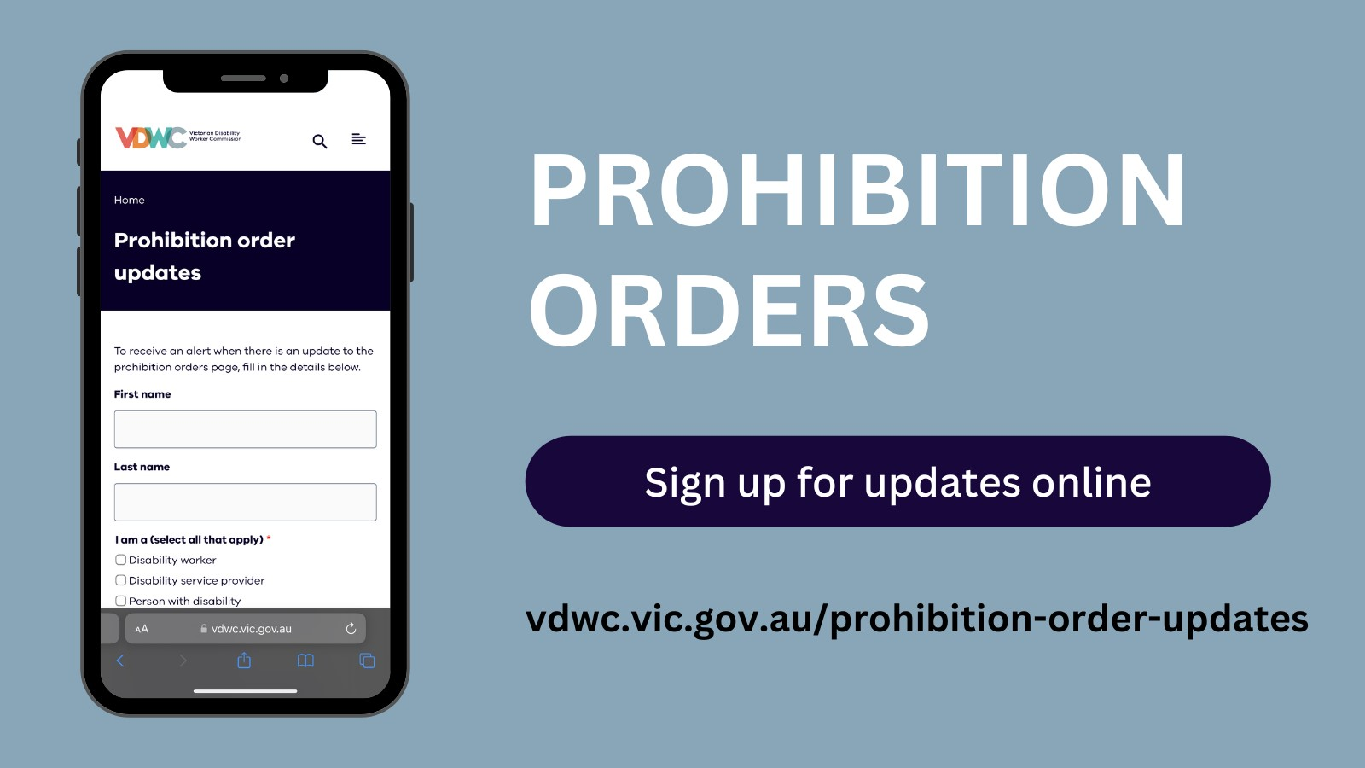
Notes:
One of the possible outcomes of a notification is a prohibition order.
A prohibition order stops a person from practising as a disability worker or requires that they can only work if certain conditions are met.
As the Commissioner, I can make a prohibition order if I am satisfied that it is necessary to avoid a serious risk to the life, health, safety or welfare of a person or the health, safety or welfare of the public.
The Commission maintains a public register of all persons to whom prohibition orders and interim prohibition orders are made. The prohibition orders are listed and available on the Commission’s website. You can also sign up to receive an alert when there is an update to the prohibition orders list on the VDWC website.

Slide 10
Disability Worker Registration
Skilled
Safe
Professional
Undertaking Continuing Professional Development
Notes:
As disability workers, you do crucial work in our communities.
A disability worker is defined by the Disability Service Safeguards Act 2018 (the Act) as a person who provides a disability service to a person with disability. Supervisors and managers of a person or people who provide a disability service are also disability workers.
Disability Worker Registration recognises workers for the important work they do and strengthens trust in disability workers and in the professionalism of the disability sector. Disability Worker Registration provides additional checks to the NDIS Worker Screening check by assessing whether a person has the necessary skills and experience to be a registered Victorian disability worker.
By becoming registered you become an employee of choice by showing employers and people with disability, that you have the necessary skills and experience and have been assessed as suitable to hold registration.
Registration is currently free and demonstrates that you’re a safe, quality worker.

Slide 11
Qualifying for registration
Registered disability support worker
qualifications
or
work experience
or
combination of both.
Registered disability practitioner
qualifications
or
professional experience
or
combination of both.
Notes:
You can register as either:
a disability support worker, who provides direct support to people with disability or supervise this work or
as a disability practitioner, which are disability workers with advanced skills, experience and qualifications
You can apply based on your professional experience and the number of hours you’ve worked in the sector, or based on qualifications in relevant fields, or a combination of both experience and qualifications.

Slide 12
Benefits of registration
Notes:
What’s in it for you?
Registered workers receive a certificate of registration and the quality tick of registration, which you can add to your resumes and profiles.
You will also be listed on the public register and recognised as a member of a professional sector that values safety, respect and quality of work. Once you are registered you are committing to complying with the registration standards. This includes undertaking ongoing learning with 10 hours Continual Professional Development each year. The Commission has a training and development catalogue on our website that you can use to find training courses and resources to continue to develop your skills. Registered workers also receive a quarterly Worker Wrap newsletter with news, information and sector insights from the Commission.

Slide 13
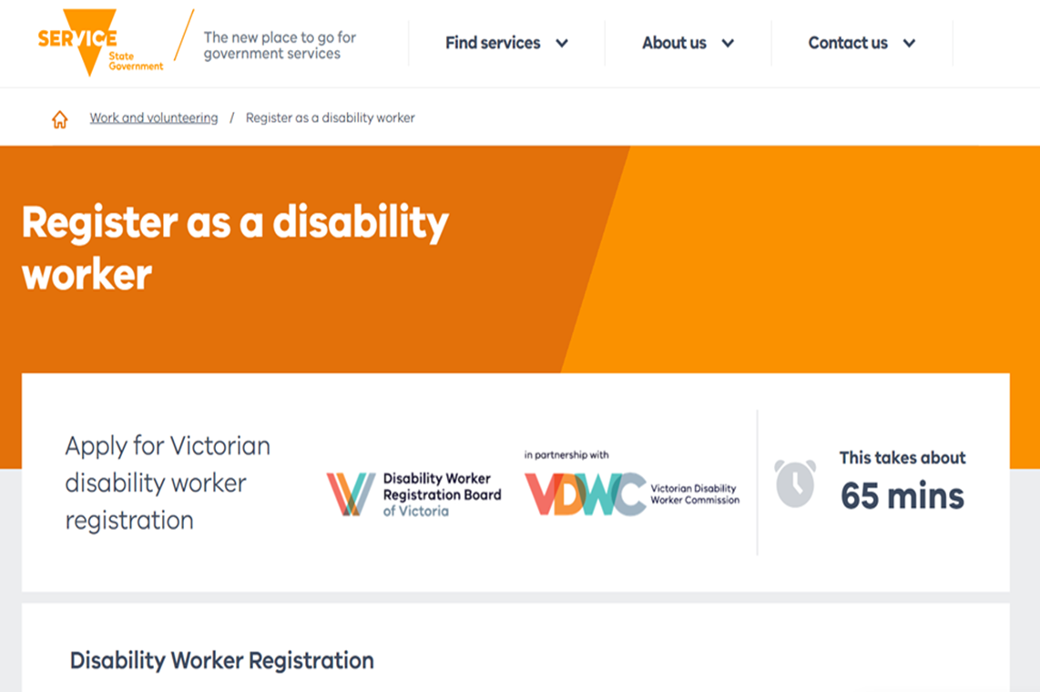
Register online:
Notes:
So, how do you register?
Registration is free and completed online through the Service Victoria website or app.
If you have used the Service Victoria website or app before and saved your profile, this will speed up your application for registration.
To apply you'll need to:
prove your identity with your ID documents
agree to a national police check (which the Commission will pay for)
complete the application form; and
provide documents to show you are qualified, either through your qualifications or your experience, and are a suitable person and have appropriate skills to practice as a registered disability worker
It will make registering a lot quicker and easier if you have your documents ready before applying.

Slide 14
Before going online:
Collect your documents
Evidence of your:
Identity
Work experience
Qualifications
Notes:
Everyone registering will need to provide:
Proof of your identity. This includes current ID documents for example a passport, drivers’ licence, learners permit, and/or Medicare card.
Proof of your experience. This could be employment documents such as payslips, statement of service, position description or letter from your employer.
If you have undertaken relevant studies, you will need to provide proof of your qualifications. This includes copies of qualification certificates or academic transcripts.
We suggest that you get these documents ready before applying online. If you don't have all these documents, you can get in touch with our team to discuss.

Slide 15
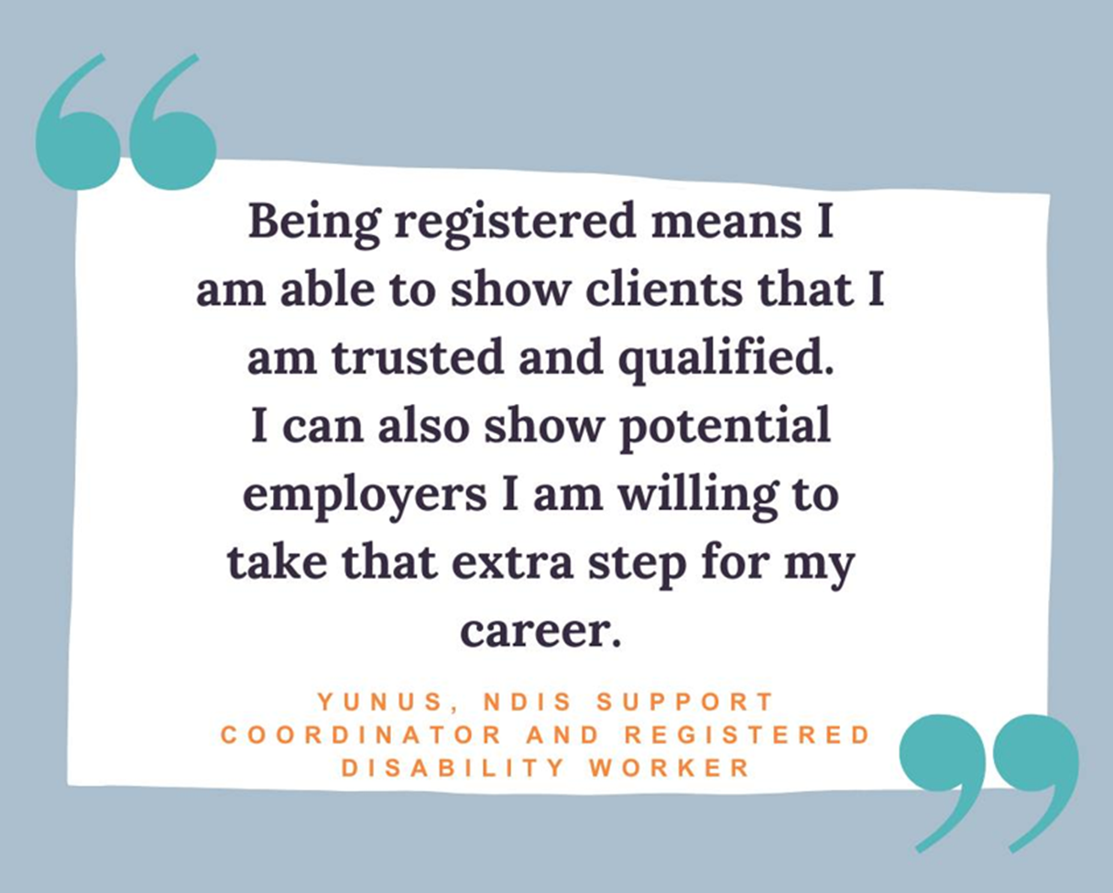
Notes:
Some people may need to provide further information and documents - don’t worry we are here to help through the process.
This might have to do with past criminal charges in Australia or overseas, disciplinary action, being registered with another regulator as a nurse, teacher or OT for instance, or a possible impairment that may affect your work.
These things do not disqualify a disability worker from becoming registered, we are just letting you know so that you can be prepared. We will contact you later if this information is needed. You can find more information on our website or contact our friendly registration team for advice.

Slide 16
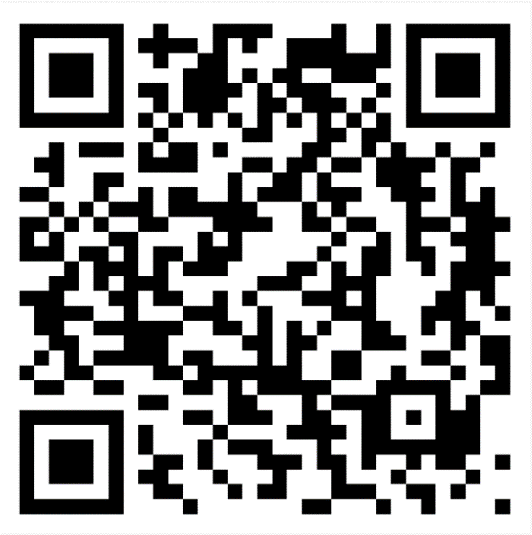
Subscribe to our newsletter at vdwc.vic.gov.au
Email: info@vdwc.vic.gov.au
Call 1800 497 132
Follow us:
facebook.com/VDWCommission
x.com/VDWCommission
linkedin.com/company/vdwcommission
vicdwcommission
Questions?
Notes:
We ask you to please consider registering, and supporting us to make a safer, stronger disability sector.
If you ever have concerns about a disability worker or need assistance with registering – please contact us.
You can email us or call us on the number on this slide.
If you have a smartphone, you can visit our website to subscribe to our newsletter via the QR code on the screen.
Or follow us on facebook, twitter, linkedin and Instagram.
Does anyone have any questions?

